Slide 1
Without Virtualization
What if we want to install Linux or Macintosh also
Windows
It’s not possible without uninstalling Windows and then installing Linux or Macintosh
Physical Machine

Slide 2
What is Hypervisor
A hypervisor is a software that enables multiple instances of operating systems to run on the same physical computing resources.

Slide 3
What is Virtualization
Before hypervisors hit the mainstream, most physical computers could only run one operating system (OS) at a time. This made them stable because the computing hardware only had to handle requests from that one OS. The downside of this approach was that it wasted resources because the operating system couldn’t always use all of the computer’s power.
A hypervisor solves that problem. It is a small software layer that enables multiple instances of operating systems to run alongside each other, sharing the same physical computing resources. This process is called virtualization, and the operating system instances are referred to as virtual machines (VMs)—software emulations of physical computers.
The hypervisor, also known as a virtual machine monitor (VMM), manages these VMs as they run alongside each other. It separates VMs from each other logically, assigning each its own slice of the underlying computing power, memory, and storage. This prevents the VMs from interfering with each other; so if, for example, one OS suffers a crash or a security compromise, the others survive.

Slide 4
With Virtualization
VM 1
VM 2
Macintosh
Ubuntu
Hypervisor
Operating System
[ Windows ]
Physical Machine

Slide 5
Main drawbacks of Virtualization
Size
Virtual machines (VMs) require significant amounts of storage space, which can be a problem, especially when running multiple VMs on a single physical host.
b) Booting time
Virtual machines often run operating systems that are designed to work on physical hardware. These operating systems have to go through the usual boot sequence, which may include hardware detection and initialization, device driver loading, and services startup—all of which take time.
c) Memory consumption
Each virtual machine requires a certain amount of memory to run its operating system and applications. The hypervisor itself also uses memory to manage the virtual machines. This means that running several VMs simultaneously can consume a large portion of the physical host’s RAM.

Slide 6
What is Docker
Docker is an open platform for developing, shipping and running application.
It is an OS virtualized software platform which allows you to package your project so that you can carry it from one place to another. Here package means which will contain not only your application but also its dependencies including software/s required also.

Slide 7
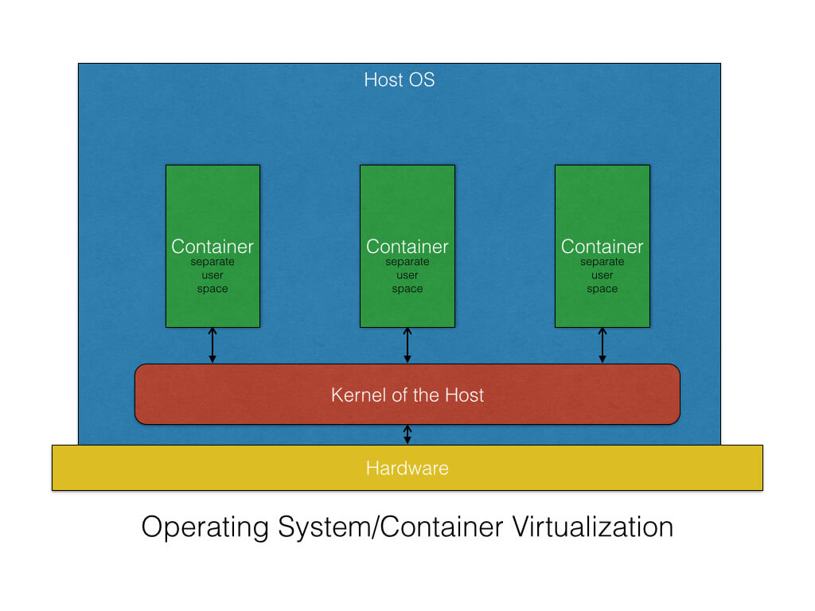

Slide 8
How Docker works
Container 2
Java 17
python 3
MySQL 8
Container 1
Java 8
python 2
Lightweight containers which contain different applications along with their dependencies including various different softwares.
Manages various containers
Docker Engine
Operating System
[Linux,Windows,Mac]
Hardware

Slide 9
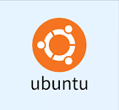


Docker Architecture
You get these when you install Docker on your system.
Storage and content delivery system for holding docker images
Docker Host
Docker Daemon
Docker Registry
http://hub.docker.com
Docker Client
Docker
images
Docker
containers
docker build
Docker images
Dockerfile
Ubuntu container
push
Python
docker pull
Nginx container
openjdk
docker run
pull
Ubuntu
Tomcat container
Njinx
docker push
And Many more

Slide 10
Which is to use when?
Virtualization :- when you want to run multiple OS
Docker:- when you want to run multiple versions of the same software e.g. Java 8, Java 11 , Java 18 ,MySQL 5 and MySQL 8 etc. together.

Slide 11
Scenario for Docker
Suppose you create a project in Development Phase which uses Java 18,MySQL 8 and Spring 6.
Now your project will go to Testing phase and finally Production phase. If during Testing and Prodution phases these exact softwares are not available, your project won’t run. In this case instead of installing everything from the scratch in these phases, you can create a container which contains your application code and the softwares it has used. Now you can distribute entire container to the Testing and Production phase where your project can be tested and deployed without any problem.

Slide 12
Docker Image
A Docker Image is a read-only file with a bunch of instructions. When these instructions are executed, it creates a Docker container.

Slide 13
Dockerfile
Dockerfile consists of specific commands that guide you on how to build a specific Docker image.
The basic purpose of Dockerfile is to build Docker image, which is then converted into Docker containers.

Slide 14
Container
Docker provides the ability to package and run an application in a loosely isolated environment called a container. The isolation and security allows you to run many containers simultaneously on a given host. Containers are lightweight and contain everything needed to run the application, so you do not need to rely on what is currently installed on the host. You can easily share containers while you work, and be sure that everyone you share with gets the same container that works in the same way.
Docker provides tooling and a platform to manage the lifecycle of your containers:
Develop your application and its supporting components using containers.
The container becomes the unit for distributing and testing your application.
When you’re ready, deploy your application into your production environment, as a container.

Slide 15
Docker Engine
The Docker Engine is the core software that runs and manages Docker containers on your computer or server. Think of it as the "brain" that makes containers work.
In simpler terms, the Docker Engine does two main things:
Creates and runs containers: It takes the instructions you give (like a Docker image) and runs it inside a container. A container is like a lightweight, isolated environment where you can run an application.
Manages containers: It keeps track of all the containers, starting them, stopping them, and handling their resources (like CPU, memory, and storage) as needed.
The Docker Engine has two main parts:
Docker Daemon (dockerd): This is the background service that actually manages containers. It listens for commands and does the heavy lifting of creating, running, and managing containers.
Docker CLI (Command-Line Interface): This is the command-line tool you use to give instructions to the Docker Daemon. For example, when you type docker run to start a container, you're using the Docker CLI to tell the Docker Daemon to start a container.
So, in short, the Docker Engine is the technology behind Docker that makes it possible to create, run, and manage containers on your system.

Slide 16
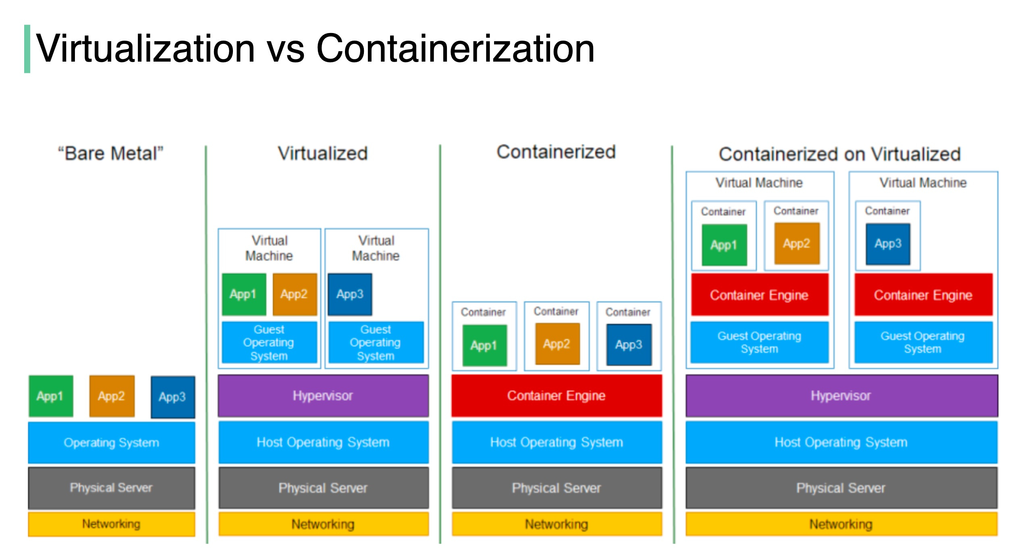

Slide 17
Virtualization vs Containerization
Virtualization
What it is: Virtualization creates virtual machines (VMs) that emulate entire physical computers, including the OS and hardware.
Isolation: Each VM runs its own full operating system with a dedicated kernel, which makes them heavier.
Resource Usage: VMs are more resource-intensive as each VM needs its own OS and hardware emulation.
Boot Time: VMs take longer to start because they boot an entire OS.
Use Case: Good for running multiple OS types on a single physical server (e.g., Windows, Linux).
Containerization
What it is: Containerization packages software and its dependencies into containers, which share the host OS kernel but are isolated from each other.
Isolation: Containers share the host OS kernel but have isolated file systems, processes, and networks.
Resource Usage: Containers are more lightweight because they share the OS kernel and don’t need full OS copies.
Boot Time: Containers start much faster since they don’t require an OS to boot.
Use Case: all containers share the same host OS kernel (e.g., Linux or Windows), but they have their own isolated environments.

